Slide 1
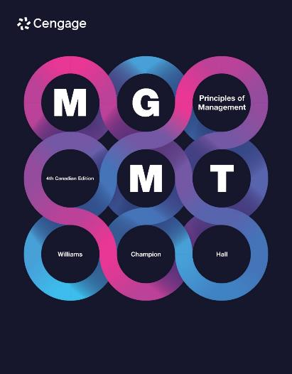

Slide 2
Chapter 6
Innovation and Change
LECTURE FIVE
9 OCT 25
Dr IKE

Slide 3
Technological Innovation and S-Curves
Technology cycle: a cycle that begins with the “birth” of a new technology and ends when that technology reaches its limits and is replaced by a newer, better technology.

Slide 4
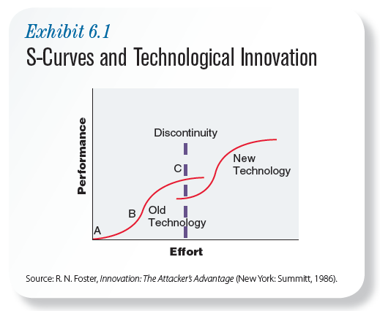
Technological Innovation and S-Curves
Notes:
S-curve pattern of innovation: a pattern of technological innovation characterized by slow initial progress, then rapid progress, and then slow progress again as a technology matures and reaches its limits.
Early in a technology cycle, there is still much to learn and progress is slow, depicted by point A on the S-curve. The flat slope indicates that increased effort (i.e., money, research, and development) brings only small improvements in technological performance. As technology matures, researchers figure out how to get better performance from new tech. This is represented by point B of the S-curve.
The steeper slope indicates that small amounts of effort will result in significant increases in performance. At point C, the flat slope again indicates that further efforts to develop this particular technology will result in only small increases in performance. More important, however, point C indicates that the performance limits of that particular technology are being reached. In other words, additional significant improvements in performance are highly unlikely. After technology has reached its limits at the top of the S-curve, improvements in performance usually come from radical new designs/new performance-enhancing materials (point C).
New technology is represented by the second S-curve. The changeover or discontinuity between the old and new technologies is represented by the dotted line. At first, the old and new technologies will likely coexist. Eventually, however, the new technology will replace the old technology. When that happens, the old technology cycle will be complete, and a new one will have started.
(Textbook example: Intel’s development of computer chips.)

Slide 5

Innovation Streams
Innovation streams: patterns of innovation over time that can create sustainable competitive advantage.
Elena Elisseeva/Shutterstock
Notes:
Discontinuous change: phase of technology cycle characterized by technological substitution and design competition
Technological substitution: the purchase of new technologies to replace older ones
Design competition: competition between old and new technologies to establish new technological standard/dominant design

Slide 6
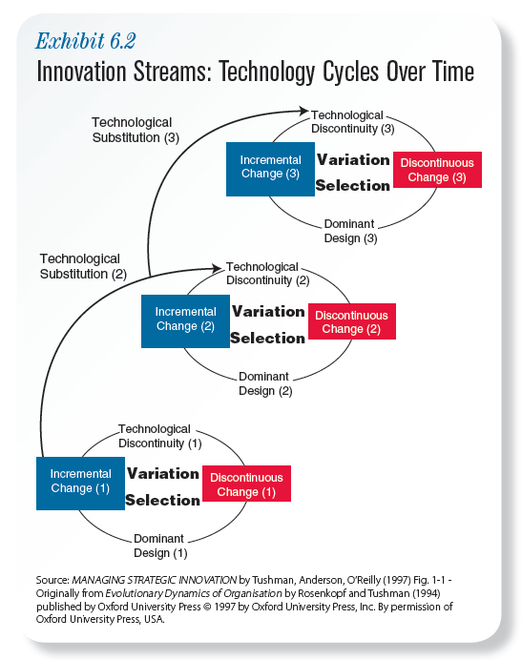
6-6
Notes:
This exhibit shows typical innovation consisting of a series of technology cycles. Recall that a technology cycle begins with a new technology and ends when that technology is replaced by a newer, substantially better technology. The innovation stream shows three technology cycles.
An innovation stream begins with a technological discontinuity, in which a scientific advance or a unique combination of existing technologies creates a significant breakthrough in performance or function. Technological discontinuities are followed by discontinuous change, which is characterized by technological substitution and design competition. Technological substitution occurs when customers then purchase new technologies to replace older technologies—like replacing a simple wall thermostat in your house. (Example: Nest)
Discontinuous change is also characterized by design competition, in which the old technology and several different new technologies compete to establish a new technological standard or dominant design.
Dominant design: new accepted market standard for technology. Dominant designs emerge in several ways. One is critical mass, meaning that a particular technology can become the dominant design simply because most people use it. A design can also become dominant if it solves a practical problem. Dominant designs can also emerge through independent standards bodies such as the International Telecommunications Union (http://www.itu.int), an agency of the United Nations that establishes standards for the communications industry (i.e., Internet, telephone, satellites, radio, etc.) to be followed worldwide.
Incremental change: the phase of a technology cycle in which companies innovate by lowering costs and improving the functioning and performance of the dominant technological design.
Technological lockout: occurs when a new dominant design (i.e., a significantly better technology) prevents a company from competitively selling its products or makes it difficult to do so.

Slide 7
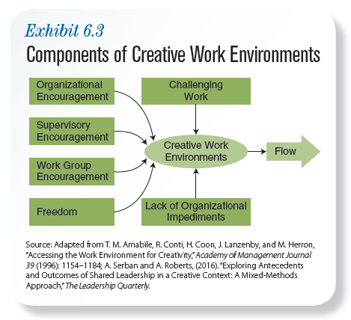
Managing Sources of Innovation Components of Creative Work Environments
6-7
Notes:
Creative work environments: workplace cultures in which workers perceive that new ideas are welcomed, valued, and encouraged. Creative work environments have six components that encourage creativity:
1. Challenging work
2. Organizational encouragement
3. Supervisory encouragement
4. Work group encouragement
5. Freedom
6. Lack of organizational impediments.
Challenging work creates a rewarding psychological experience known as “flow” (a psychological state of effortlessness in which you become completely absorbed in what you’re doing and time seems to fly).
Organizational encouragement of creativity occurs when management encourages risk taking and new ideas, supports and fairly evaluates new ideas, rewards and recognizes creativity, and encourages the sharing of new ideas throughout the company.
Supervisory encouragement of creativity occurs when supervisors provide clear goals, encourage open interaction with subordinates, and actively support development teams’ work and ideas.
Work group encouragement occurs when group members have diverse experience, education, and backgrounds and when the group fosters mutual openness to ideas; positive, constructive challenges to ideas; and shared commitment to ideas.
Freedom means having autonomy over one’s day-to-day work and a sense of ownership and control over one’s ideas.
Lack of organizational impediments such as internal conflict, power struggles, rigid management structures, and a conservative bias toward the status quo which discourage creativity.

Slide 8
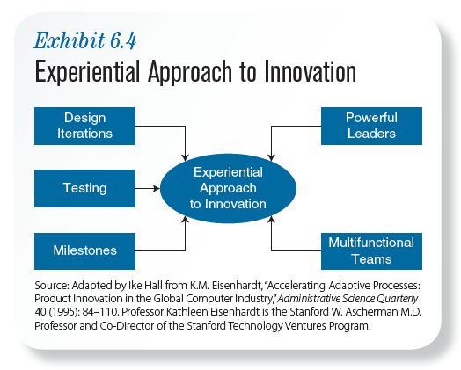
Five Aspects of Experiential Approach to Innovation
8
6-8
Notes:
An “iteration” is a repetition.
Design iteration: cycle of repetition in which a company tests prototype of new product/service, improves on design, and builds and tests the improved prototype
Product prototype: full-scale working model being tested for design, function, and reliability
Testing: systematic comparison of different product designs/design iterations. Companies that want to create new dominant design following technological discontinuity quickly build, test, improve, and retest series of different product prototypes.
Milestones: formal project review points used to assess progress and performance. By making people regularly assess what they’re doing, how well they’re performing, and whether they need to take corrective action, milestones provide structure to general chaos that follows technological discontinuities. Milestones also shorten the innovation process by creating a sense of urgency that keeps everyone on task.
Multifunctional teams are work teams composed of people from different departments.

Slide 9
Managing Innovation During Incremental Change Compression Approach to Innovation
Planning
Supplier Involvement
Shortening Time of Individual Steps
Overlapping
Steps
Multifunctional Teams
9
6-9
Notes:
When planning for incremental innovation, the goal is to squeeze or compress development time as much as possible, and the general strategy is to create a series of planned steps to accomplish that goal. Most planning for incremental innovation is based on the idea of generational change.
Generational change occurs when incremental improvements are made to dominant technological design such that the improved version of technology is fully backward compatible with the older version.
Because the compression approach assumes that innovation can follow a series of preplanned steps, one of the ways to shorten development time is supplier involvement. Delegating some of the preplanned steps in the innovation process to outside suppliers reduces the amount of work internal development teams must do.
Another way to shorten development time is to shorten the time of individual steps in the innovation process. One of the most common ways to do that is through computer-aided design (CAD). In a sequential design process, each step must be completed before the next step begins. Sometimes multiple development steps can be performed at the same time. Overlapping steps shorten the development process by reducing delays or waiting time between steps.

Slide 10
Managing Innovation
Experiential Approach
Compression Approach
used to manage innovation in highly uncertain environments during periods of discontinuous change
Goals:
significant improvements in performance and the establishment of a new dominant design
Strategies:
to build something new, different, and substantially better
used to manage innovation in more certain environments during periods of incremental change
Goals:
lower costs and incremental improvements in the performance and function of the existing dominant design
Strategies:
compress the time and steps needed to bring about small, consistent improvements in performance and functionality
Notes:
Distinguishing characteristics of the two approaches:
The experiential approach is used to manage innovation in highly uncertain environments during periods of discontinuous change; the compression approach is used to manage innovation in more certain environments during periods of incremental change.
The goals of the experiential approach are significant improvements in performance and the establishment of a new dominant design; the goals of the compression approach are lower costs and incremental improvements in the performance and function of the existing dominant design.
The general strategies in each approach are different. With the experiential approach, the general strategy is to build something new, different, and substantially better. Because there’s so much uncertainty—no one knows which technology will become the market leader—companies adopt a winner-take-all approach by trying to create the market-leading, dominant design. With the compression approach, the general strategy is to compress the time and steps needed to bring about small, consistent improvements in performance and functionality. Because a dominant technology design already exists, the general strategy is to continue improving the existing technology as rapidly as possible.

Slide 11
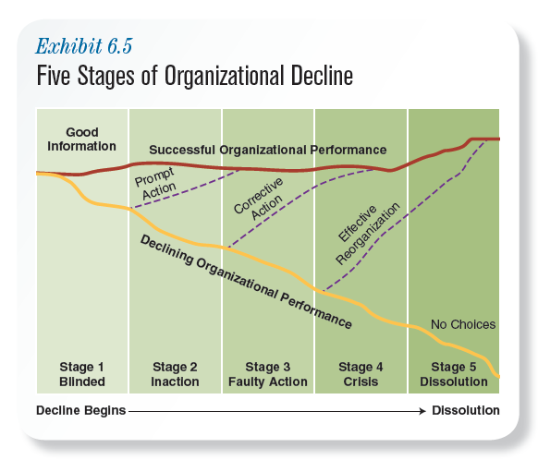
11
Notes:
Businesses operate in a constantly changing environment. Recognizing and adapting to internal and external changes can mean the difference between continued success and going out of business. Companies that fail to change run the risk of organizational decline.
Organizational decline: a large decrease in organizational performance that occurs when companies don’t anticipate, recognize, neutralize, or adapt to the internal or external pressures that threaten their survival.
Stages
Blinded stage: Decline begins because key managers don’t recognize internal/external changes that will harm organizations. “Blindness” may be due to lack of awareness about changes. May stem from inability to understand significance of changes. Or may come from overconfidence that develops when companies have been successful.
Inaction stage: Organizational performance problems become more visible; management may recognize the need to change but still take no action. Managers may be waiting to see if the problems will correct themselves. Or they may find it difficult to change previous practices/policies that once led to success. Another reason could be they wrongly assume they can make changes to correct problems, so don’t feel problems are urgent.
Faulty action: Due to rising costs and decreasing profits and market share, management will announce “belt-tightening” plans designed to cut costs, increase efficiency, and restore profits. Rather than recognizing the need for fundamental changes, managers assume they just run a “tighter ship” and company performance will return to previous levels.
Crisis stage: Bankruptcy/dissolution (i.e., breaking up and selling different parts of company) is likely to occur unless the company completely reorganizes the way it does business. Companies typically lack the resources needed to change how they run their business.
Dissolution stage: After failing to make the changes needed to sustain the organization, the company is dissolved through bankruptcy proceedings such as selling assets to pay suppliers, banks, and creditors.

Slide 12
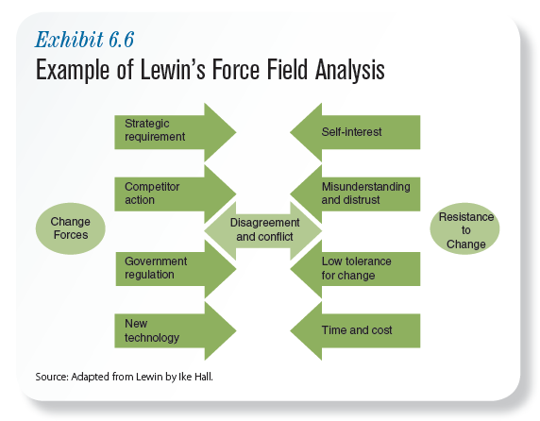
Notes:
Change forces: forces that produce differences in the form, quality, or condition of an organization over time. These include new strategic requirements (new kind of differentiation), closely tied to competitor action; changes in government regulation (e.g., in trade policies, taxation, and environmental laws); and new technologies (including new manufacturing processes, new methods, and new machinery). These forces for change often cause disagreement and conflict, not necessarily over the need for change, but over how change is implemented, over what we actually change in our organizations. By contrast, resistance forces support the status quo (the existing conditions in organizations).
Resistance to change is caused by self-interest, misunderstanding and distrust, and general intolerance for change. People resist change out of self-interest because they fear that change will cost/deprive them of something they value. People resist change because of misunderstanding and distrust because they don’t understand change or the reasons for it, or they distrust the people—typically management—behind change. Resistance may come from generally low tolerance for change. Some people are less capable of handling change than others. People with low tolerance for change feel threatened by the uncertainty associated with change and worry that they won’t be able to learn new skills and behaviours they need in order to successfully negotiate change in companies.
The final factor usually falls into the time and cost area. People in an organization generally only accept that change is inevitable just at the point when they have the least amount of time/resources to effect change—when it’s too late!

Slide 13
Managing Resistance to Change Kurt Lewin’s Managing Change Model
UNFREEZE
CHANGE
FREEZE
*Believe that change is
needed
*Share reasons,
communicate, and
empathize
*Change behaviour/work
practices
*Explain why; champion
change; create
opportunities for feedback;
timing; security; educate;
don’t rush
*Support and reinforce
*Make it “stick”
*Educate/communicate
*Participate
*Negotiate
*Managerial support
*Coercion
Notes:
According to Kurt Lewin, managing organizational change is the basic process of unfreezing, change intervention, and refreezing. Unfreezing is getting people affected by change to believe that change is needed. During change intervention itself, workers and managers change their behaviour and work practices. Refreezing involves supporting and reinforcing new changes so they “stick.”
Resistance to change is based on insufficient, incorrect, or misleading information. Managers should educate employees about the need for change and communicate change-related information to them. Managers must also supply information and funding or other support employees need to make changes.
One way to reduce resistance to change: have those affected by change participate in planning/implementing change process. Employees who participate have a better understanding of change and the need for it. Employee concerns about change can be addressed as they occur if employees participate in planning/implementation process.
Employees are less likely to resist change if they are allowed to discuss and agree on who will do what after change occurs. Resistance to change decreases when change efforts receive significant managerial support. Top managers must do more than talk about the importance of change. They must provide training, resources, and the autonomy needed to make change happen.
Use of formal power/authority to force others to change is called coercion. Because of intense negative reactions it can create (i.e., fear, stress, resentment, sabotage of company products), coercion should only be used when a crisis exists or when all other attempts to reduce resistance to change have failed.

Slide 14
Errors Managers Make When Leading Change
Unfreezing
Not establishing a great enough sense of urgency
Not creating a powerful enough guiding coalition
Change
Lacking a vision
Undercommunicating the vision by a factor of ten
Not removing obstacles to the new vision
Not systematically planning for and creating short-term wins
Refreezing
Declaring victory too soon
Not anchoring changes in the corporation’s culture

Slide 15
How to Create a Results-Driven Change Program
Set measurable, short-term goals to improve performance.
Make sure your action steps are likely to improve measured performance.
Stress the importance of immediate improvements.
Solicit help from consultants and staffers to achieve quick improvements in performance.
Test action steps to see if they actually yield improvements. If they don’t, discard them and establish new ones.
Use resources that you have or can easily acquire. It doesn’t take much.
Sources: H. Robinson, “An Overview of Change Management: The Identification of the Critical Success Factors That Will Ensure the Survival and Progression of an Organization,” (2012). University of Johannesburg, https://ujdigispace.uj.ac.za/handle/10210/7283. Reprinted by permission of Harvard Business Review (exhibit) from “Successful Change Programs Begin With Results,” by R. H. Schaffer & H. A. Thomson, J.D, Harvard Business Review on Change (Boston: Harvard Business School Press,1998),189–213. Copyright 1998 by the Harvard Business School Publishing Corporation; all rights reserved.
6-15
Notes:
From Exhibit 6.7.

Slide 16
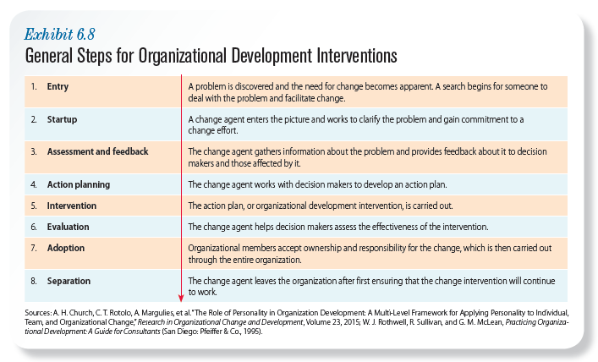
General Steps for Organizational Development Interventions
6-16
Notes:
Organizational development (OD) interventions begin with the recognition of the problem. Then, the company designates a change agent to be formally in charge of guiding the change effort. The person can be someone from the company or a professional consultant. The change agent clarifies the problem, gathers information, works with decision makers to create and implement an action plan, helps evaluate the plan’s effectiveness, implements the plan throughout the company, and leaves (if outside the company) after making sure the change intervention will continue to work.

Slide 17
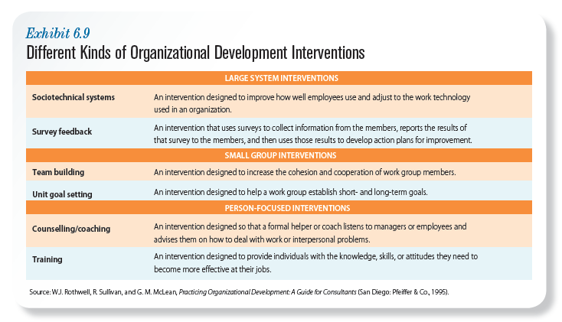
Different Kinds of Organizational Development Interventions
6-17
Notes:
The exhibit describes the most frequently used organizational development interventions for large systems, small groups, and people.

